Slide 1
Detection Error Probability Maximization for Disguised Full-Duplex Covert Communications
REFAT KHAN
Advised by Professor Jihwan Moon
Cognitive Communication System Lab
Department Of Mobile Convergence Engineering
Hanbat National University
June 12, 2024

Slide 2
Motivations
Motivations Contributions
Wireless Communication
Securing Wireless Communication
Wireless technology transforms lives, but cyberattacks pose a threat, leading to potential information leaks
To cope with this, cryptography has widely been adopted
The perspective of physical layer security
Yet, cryptography has limitations: complex key generation and susceptibility to
powerful eavesdroppers, especially challenging for IoT devices.
These downsides have led researchers to examine the possibility of utilizing physical layer security
A new line of secure communications: Covert Communication
Covert communication
Opponents can conduct traffic analysis by collecting metadata during transmission.
Vulnerabilities include capturing source and destination addresses, request-response frequency, etc
Eve
Alice
Bob

Slide 3
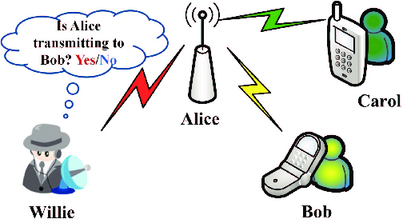
Motivations
Motivations Contributions
A new line of secure communications: Covert Communication
Need for Covert Communications
Transmit data in a manner that avoids detection or suspicion
Combining cryptography and physical layer security can prevent eavesdropping, but covert communications are necessary to counter traffic analysis threats
Unveiling Covert Communication: Discovering Full-Duplex (FD) Systems
System Overview
Setup involves a source node and disguised full-duplex (FD) destination node.
Objectives
Ensure covert transmission to a hidden receiver with warden node surveillance.
Prioritizing a minimum covert rate within the system
Research Scope
Explore channel uncertainty at the warden node.
Determine the lower bound of the expected minimum detection error probability (DEP).

Slide 4
Contributions
Motivations Contributions
Dissertation
Detection Error Probability Maximization for Disguised Full-Duplex Covert Communications
Enhancing Covert Communication System Performance
Overview
Our research focuses on enhancing the performance of a covert communication system
Covert transmission from the destination node to a hidden receiver via an unseen antenna setup
Surveillance and Objectives
Surveillance
Operation under the monitoring of a warden node to detect suspicious communications.
Objectives
Optimization of public data rate and transmit power of FD destination node to maximize DEP.
Prioritizing a minimum covert rate within the system

Slide 5
Outline
.
System model
Problem Formulation
Proposed Solution
Numerical results
Conclusion

Slide 6






System Model
System Model Problem Formulation Proposed Solution Numerical Result Conclusion
2. Schematic Diagram
Hidden Receiver, R
Covert Message
Self-interference
Source, S
Public Message
Disguised FD destination, D
Warden, W

Slide 7



System Model
System Model Problem Formulation Proposed Solution Numerical Result Conclusion
2.1 Received signals
At the disguised FD destination $D$
$y_{D}=h_{SD}\sqrt{P_{S}}x_{P}+{\tilde{h}}_{DD}\sqrt{P_{D}}x_{C}+z_{D}$
$x_{P}\sim CN\left(0,1\right)$: Public message
$x_{C}\sim CN\left(0,1\right)$: Covert message
$P_{S}$: Transmit power at the source
$P_{D}$: Transmit power at the covert FD destination
${\tilde{h}}_{DD}\sim CN\left(0,σ_{SI}^{2}\right)$: Residual self interference after self interference cancellation
Public Message,${ x}_{P}$
Covert Message, $x_{C}$
Disguised FD destination, D
Source, S

Slide 8



System Model
System Model Problem Formulation Proposed Solution Numerical Result Conclusion
2.1 Received Signals
At the disguised FD destination $D$
Channel capacity for the public message
${\bar{r}}_{P,D}=\log_{2}\left(1+\frac{{\left|h_{SD}\right|}^{2}P_{S}}{{\left|{\tilde{h}}_{DD}\right|}^{2}P_{D}+σ_{D}^{2}}\right)$
Adaptive transmission policy with rate $r_{P}≤{\overline{r}}_{P,D}$ assumed, based on the feedback from the destination
Public Message,$x_{P}$
Covert Message,$x_{C}$
Disguised FD destination, D
Source, S

Slide 9


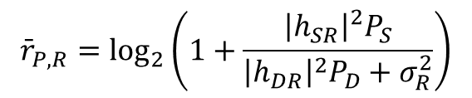


System Model
System Model Problem Formulation Proposed Solution Numerical Result Conclusion
2.1 Received signals
At the hidden receiver $R$
Channel capacity for the public message by treating the covert message as interference (if $r_{P}≤{\overline{r}}_{P,R}$)
$$y_{R}=h_{SR}\sqrt{P_{S}}x_{P}+h_{DR}\sqrt{P_{D}}x_{C}+z_{R}$$
$${\bar{r}}_{P,R}=\log_{2}\left(1+\frac{{\left|h_{SR}\right|}^{2}P_{S}}{{\left|h_{DR}\right|}^{2}P_{D}+σ_{R}^{2}}\right)$$
Public Message,${ x}_{P}$
Covert Message, $x_{C}$
Disguised FD destination, D
Source, S
Hidden
receiver, R

Slide 10

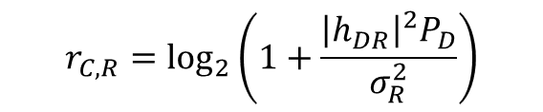
System Model
System Model Problem Formulation Proposed Solution Numerical Result Conclusion
2.1 Received signals
At the hidden receiver $R$
Achievable rate for the covert message after canceling the decoded public message
$$y_{R}=h_{SR}\sqrt{P_{S}}x_{P}+h_{DR}\sqrt{P_{D}}x_{C}+z_{R}$$
$$r_{C,R}=\log_{2}\left(1+\frac{{\left|h_{DR}\right|}^{2}P_{D}}{σ_{R}^{2}}\right)$$
Public Message,${ x}_{P}$
Covert Message, $x_{C}$
Disguised FD destination, D
Source, S
Hidden
receiver, R

Slide 11


System Model
System Model Problem Formulation Proposed Solution Numerical Result Conclusion
2.2 Covert Message Detection
At the warden $W$
Achievable rate for the covert message after canceling the decoded public message
$$y_{W}=h_{SW}\sqrt{P_{S}}x_{P}+h_{DW}\sqrt{P_{D}}x_{C}+z_{W}$$
$$r_{C,R}=\log_{2}\left(1+\frac{{\left|h_{DR}\right|}^{2}P_{D}}{σ_{R}^{2}}\right)$$
Public Message,${ x}_{P}$
Covert Message, $x_{C}$
Disguised FD destination, D
Source, S
Warden, W

Slide 12


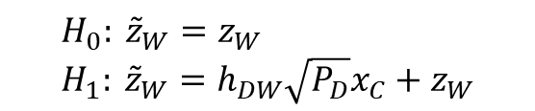

System Model
System Model Problem Formulation Proposed Solution Numerical Result Conclusion
2.2 Covert Message Detection
The worst-case assumption: $P_{D}$ known at the detector [HTa:20]
The effective residual signal assuming the warden successfully decoded $x_{P}$
The null and alternative hypotheses
The test statistics $T=E\left[{\left|{\tilde{z}}_{W}\right|}^{2}\right]$
$${\tilde{z}}_{W}=y_{W}−h_{SW}\sqrt{P_{S}}x_{P}$$
$$H_{0}: {\tilde{z}}_{W}=z_{W} \\ H_{1}: {\tilde{z}}_{W}=h_{DW}\sqrt{P_{D}}x_{C}+z_{W}$$
$$H_{0}: T=σ_{W}^{2} \\ H_{1}: T={\left|h_{DW}\right|}^{2}P_{D}+σ_{W}^{2}$$

Slide 13

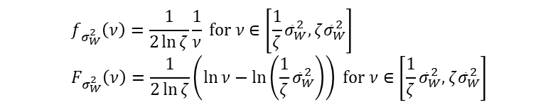
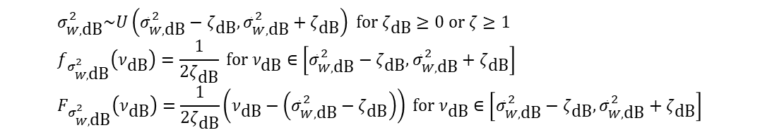
System Model
System Model Problem Formulation Proposed Solution Numerical Result Conclusion
2.2 Covert Message Detection
The worst-case assumption: $P_{D}$ known at the detector [HTa:20]
Noise uncertainty
Bounded uncertainty model with the mean noise power ${\overline{σ}}_{W,dB}^{2}$
By change of variables with $σ_{W,dB}^{2}=10\log_{10}{σ_{W}^{2}}$
$$σ_{W,\text{dB}}^{2}\sim U\left({\bar{σ}}_{W,\text{dB}}^{2}−ζ_{\text{dB}},{\bar{σ}}_{W,\text{dB}}^{2}+ζ_{\text{dB}}\right) \text{for} ζ_{\text{dB}}≥0 \text{or} ζ≥1 \\ f_{σ_{W,\text{dB}}^{2}}\left(ν_{\text{dB}}\right)=\frac{1}{2ζ_{\text{dB}}} \text{for} ν_{\text{dB}}∈\left[{\bar{σ}}_{W,\text{dB}}^{2}−ζ_{\text{dB}},{\bar{σ}}_{W,\text{dB}}^{2}+ζ_{\text{dB}}\right] \\ F_{σ_{W,\text{dB}}^{2}}\left(ν_{\text{dB}}\right)=\frac{1}{2ζ_{\text{dB}}}\left(ν_{\text{dB}}−\left({\bar{σ}}_{W,\text{dB}}^{2}−ζ_{\text{dB}}\right)\right) \text{for} ν_{\text{dB}}∈\left[{\bar{σ}}_{W,\text{dB}}^{2}−ζ_{\text{dB}},{\bar{σ}}_{W,\text{dB}}^{2}+ζ_{\text{dB}}\right]$$
$$f_{σ_{W}^{2}}\left(ν\right)=\frac{1}{2\ln{ζ}}\frac{1}{ν} \text{for} ν∈\left[\frac{1}{ζ}{\bar{σ}}_{W}^{2},ζ{\bar{σ}}_{W}^{2}\right] \\ F_{σ_{W}^{2}}\left(ν\right)=\frac{1}{2\ln{ζ}}\left(\ln{ν}−\ln\left(\frac{1}{ζ}{\bar{σ}}_{W}^{2}\right)\right) \text{for} ν∈\left[\frac{1}{ζ}{\bar{σ}}_{W}^{2},ζ{\bar{σ}}_{W}^{2}\right]$$

Slide 14

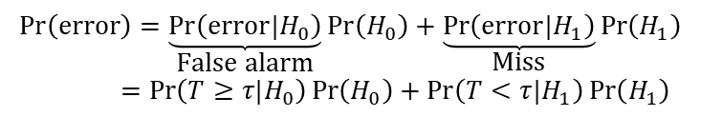

System Model
System Model Problem Formulation Proposed Solution Numerical Result Conclusion
2.2 Covert Message Detection
The worst-case assumption: $P_{D}$ known at the detector [HTa:20]
Noise uncertainty
Decision based on a threshold $τ$
Detection error probability (DEP)
False alarm probability
$$T\begin{matrix}\overset{H_{1}}{≥} \\ \underset{H_{0}}{<}\end{matrix}τ$$
$$\operatorname{Pr}\left(\text{error}\right)=\underset{\text{False} \text{alarm}}{\underbrace{\operatorname{Pr}\left(\text{error}|H_{0}\right)}}\operatorname{Pr}\left(H_{0}\right)+\underset{\text{Miss}}{\underbrace{\operatorname{Pr}\left(\text{error}|H_{1}\right)}}\operatorname{Pr}\left(H_{1}\right) \\ =\operatorname{Pr}\left(T≥τ|H_{0}\right)\operatorname{Pr}\left(H_{0}\right)+\operatorname{Pr}\left(T<τ|H_{1}\right)\operatorname{Pr}\left(H_{1}\right)$$
$$\operatorname{Pr}\left(T≥τ|H_{0}\right)=\operatorname{Pr}\left(σ_{W}^{2}≥τ\right)=1−F_{σ_{W}^{2}}\left(τ\right)=1−\frac{1}{2\ln{ζ}}\left(\ln{τ}−\ln\left(\frac{1}{ζ}{\bar{σ}}_{W}^{2}\right)\right) \text{for} τ∈\left[\frac{1}{ζ}{\bar{σ}}_{W}^{2},ζ{\bar{σ}}_{W}^{2}\right]$$

Slide 15

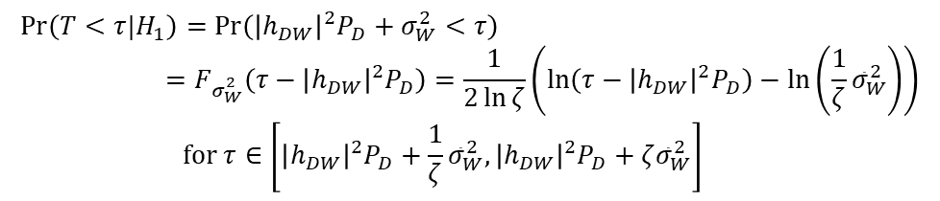

System Model
System Model Problem Formulation Proposed Solution Numerical Result Conclusion
2.2 Covert Message Detection
The worst-case assumption: $P_{D}$ known at the detector [HTa:20]
Noise uncertainty
Decision based on a threshold $τ$
Detection error probability (DEP)
Miss probability
$$T\begin{matrix}\overset{H_{1}}{≥} \\ \underset{H_{0}}{<}\end{matrix}τ$$
$$\operatorname{Pr}\left(\text{error}\right)=\underset{\text{False} \text{alarm}}{\underbrace{\operatorname{Pr}\left(\text{error}|H_{0}\right)}}\operatorname{Pr}\left(H_{0}\right)+\underset{\text{Miss}}{\underbrace{\operatorname{Pr}\left(\text{error}|H_{1}\right)}}\operatorname{Pr}\left(H_{1}\right) \\ =\operatorname{Pr}\left(T≥τ|H_{0}\right)\operatorname{Pr}\left(H_{0}\right)+\operatorname{Pr}\left(T<τ|H_{1}\right)\operatorname{Pr}\left(H_{1}\right)$$
$$\operatorname{Pr}\left(T<τ|H_{1}\right)=\operatorname{Pr}\left({\left|h_{DW}\right|}^{2}P_{D}+σ_{W}^{2}<τ\right) \\ =F_{σ_{W}^{2}}\left(τ−{\left|h_{DW}\right|}^{2}P_{D}\right)=\frac{1}{2\ln{ζ}}\left(\ln\left(τ−{\left|h_{DW}\right|}^{2}P_{D}\right)−\ln\left(\frac{1}{ζ}{\bar{σ}}_{W}^{2}\right)\right) \\ \text{for} τ∈\left[{\left|h_{DW}\right|}^{2}P_{D}+\frac{1}{ζ}{\bar{σ}}_{W}^{2},{\left|h_{DW}\right|}^{2}P_{D}+ζ{\bar{σ}}_{W}^{2}\right]$$

Slide 16


System Model
System Model Problem Formulation Proposed Solution Numerical Result Conclusion
2.2 Covert Message Detection
The worst-case assumption: $P_{D}$ known at the detector [HTa:20]
Noise uncertainty
Decision based on a threshold $τ$
Detection error probability (DEP)
Assuming the equally probable chance of the covert message, $\operatorname{Pr}\left(H_{0}\right)=\operatorname{Pr}\left(H_{1}\right)=\frac{1}{2}$
$$T\begin{matrix}\overset{H_{1}}{≥} \\ \underset{H_{0}}{<}\end{matrix}τ$$
$$① ζ{\bar{σ}}_{W}^{2}<{\left|h_{DW}\right|}^{2}P_{D}+\frac{1}{ζ}{\bar{σ}}_{W}^{2} \\ \operatorname{Pr}\left(\text{error}\right)=\left\{\begin{matrix}\frac{1}{2}\operatorname{Pr}\left(T≥τ|H_{0}\right) & , τ∈\left[\frac{1}{ζ}{\bar{σ}}_{W}^{2},ζ{\bar{σ}}_{W}^{2}\right] \\ 0 & , τ∈\left[ζ{\bar{σ}}_{W}^{2},{\left|h_{DW}\right|}^{2}P_{D}+\frac{1}{ζ}{\bar{σ}}_{W}^{2}\right] \\ \frac{1}{2}\operatorname{Pr}\left(T<τ|H_{1}\right) & , τ∈\left[{\left|h_{DW}\right|}^{2}P_{D}+\frac{1}{ζ}{\bar{σ}}_{W}^{2},{\left|h_{DW}\right|}^{2}P_{D}+ζ{\bar{σ}}_{W}^{2}\right]\end{matrix}\right.$$

Slide 17

System Model
System Model Problem Formulation Proposed Solution Numerical Result Conclusion
2.2 Covert Message Detection
The worst-case assumption: $P_{D}$ known at the detector [HTa:20]
Noise uncertainty
Decision based on a threshold $τ$
Detection error probability (DEP)
Assuming the equally probable chance of the covert message, $\operatorname{Pr}\left(H_{0}\right)=\operatorname{Pr}\left(H_{1}\right)=\frac{1}{2}$
$$T\begin{matrix}\overset{H_{1}}{≥} \\ \underset{H_{0}}{<}\end{matrix}τ$$
$$② ζ{\bar{σ}}_{W}^{2}≥{\left|h_{DW}\right|}^{2}P_{D}+\frac{1}{ζ}{\bar{σ}}_{W}^{2} \\ \operatorname{Pr}\left(\text{error}\right)=\left\{\begin{matrix}\frac{1}{2}\operatorname{Pr}\left(T≥τ|H_{0}\right) & , τ∈\left[\frac{1}{ζ}{\bar{σ}}_{W}^{2},{\left|h_{DW}\right|}^{2}P_{D}+\frac{1}{ζ}{\bar{σ}}_{W}^{2}\right] \\ \frac{1}{2}\left(\operatorname{Pr}\left(T≥τ|H_{0}\right)+\operatorname{Pr}\left(T<τ|H_{1}\right)\right) & , τ∈\left[{\left|h_{DW}\right|}^{2}P_{D}+\frac{1}{ζ}{\bar{σ}}_{W}^{2},ζ{\bar{σ}}_{W}^{2}\right] \\ \frac{1}{2}\operatorname{Pr}\left(T<τ|H_{1}\right) & , τ∈\left[ζ{\bar{σ}}_{W}^{2},{\left|h_{DW}\right|}^{2}P_{D}+ζ{\bar{σ}}_{W}^{2}\right]\end{matrix}\right.$$

Slide 18









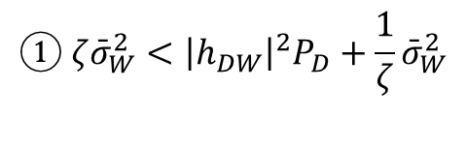


System Model
System Model Problem Formulation Proposed Solution Numerical Result Conclusion
2.2 Covert Message Detection
The worst-case assumption: $P_{D}$ known at the detector [HTa:20]
The shape of the DEP function
$$① ζ{\bar{σ}}_{W}^{2}<{\left|h_{DW}\right|}^{2}P_{D}+\frac{1}{ζ}{\bar{σ}}_{W}^{2}$$
$$Pr⁡(error)$$
$$\frac{1}{2}$$
Maximum error
= A random guess
$$\frac{1}{2}\operatorname{Pr}\left(T≥τ|H_{0}\right)$$
$$\frac{1}{2}\operatorname{Pr}\left(T<τ|H_{1}\right)$$
$$0$$
$$0$$
$$\frac{1}{ζ}{\bar{σ}}_{W}^{2}$$
$${\left|h_{DW}\right|}^{2}P_{D}+\frac{1}{ζ}{\bar{σ}}_{W}^{2}$$
$${\left|h_{DW}\right|}^{2}P_{D}+ζ{\bar{σ}}_{W}^{2}$$
$$ζ{\bar{σ}}_{W}^{2}$$

Slide 19

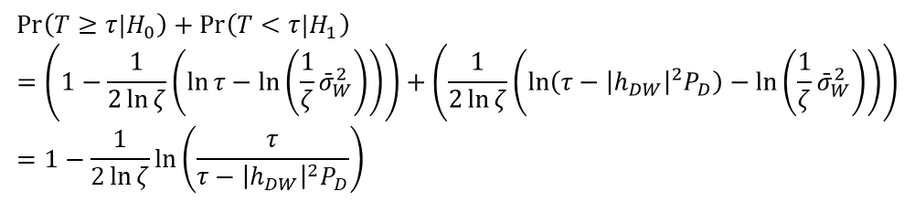
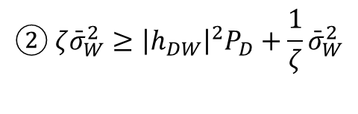
System Model
System Model Problem Formulation Proposed Solution Numerical Result Conclusion
2.2 Covert Message Detection
The worst-case assumption: $P_{D}$ known at the detector [HTa:20]
The shape of the DEP function
Note that
The first derivative
$$② ζ{\bar{σ}}_{W}^{2}≥{\left|h_{DW}\right|}^{2}P_{D}+\frac{1}{ζ}{\bar{σ}}_{W}^{2}$$
$$\operatorname{Pr}\left(T≥τ|H_{0}\right)+\operatorname{Pr}\left(T<τ|H_{1}\right) \\ =\left(1−\frac{1}{2\ln{ζ}}\left(\ln{τ}−\ln\left(\frac{1}{ζ}{\bar{σ}}_{W}^{2}\right)\right)\right)+\left(\frac{1}{2\ln{ζ}}\left(\ln\left(τ−{\left|h_{DW}\right|}^{2}P_{D}\right)−\ln\left(\frac{1}{ζ}{\bar{σ}}_{W}^{2}\right)\right)\right) \\ =1−\frac{1}{2\ln{ζ}}\ln\left(\frac{τ}{τ−{\left|h_{DW}\right|}^{2}P_{D}}\right)$$
$$\frac{∂}{∂τ}\left(\operatorname{Pr}\left(T≥τ|H_{0}\right)+\operatorname{Pr}\left(T<τ|H_{1}\right)\right)=\frac{1}{2\ln{ζ}}\frac{{\left|h_{DW}\right|}^{2}P_{D}}{τ\left(τ−{\left|h_{DW}\right|}^{2}P_{D}\right)} ⇒ \text{Increasing} \text{for} τ≥{\left|h_{DW}\right|}^{2}P_{D}$$

Slide 20


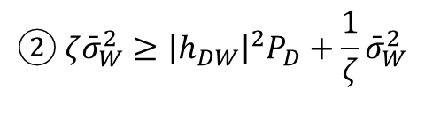
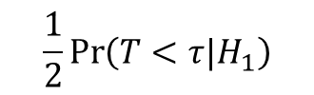
System Model
System Model Problem Formulation Proposed Solution Numerical Result Conclusion
2.2 Covert Message Detection
The worst-case assumption: $P_{D}$ known at the detector [HTa:20]
The shape of the DEP function
$$② ζ{\bar{σ}}_{W}^{2}≥{\left|h_{DW}\right|}^{2}P_{D}+\frac{1}{ζ}{\bar{σ}}_{W}^{2}$$
$$Pr⁡(error)$$
$$\frac{1}{2}$$
$$\frac{1}{2}\operatorname{Pr}\left(T≥τ|H_{0}\right) \\ +\frac{1}{2}\operatorname{Pr}\left(T<τ|H_{1}\right)$$
Maximum error
= A random guess
$$\frac{1}{2}\operatorname{Pr}\left(T≥τ|H_{0}\right)$$
$$\frac{1}{2}\operatorname{Pr}\left(T<τ|H_{1}\right)$$
$$0$$
$$0$$
$$\frac{1}{ζ}{\bar{σ}}_{W}^{2}$$
$${\left|h_{DW}\right|}^{2}P_{D}+\frac{1}{ζ}{\bar{σ}}_{W}^{2}$$
$${\left|h_{DW}\right|}^{2}P_{D}+ζ{\bar{σ}}_{W}^{2}$$
$$ζ{\bar{σ}}_{W}^{2}$$

Slide 21

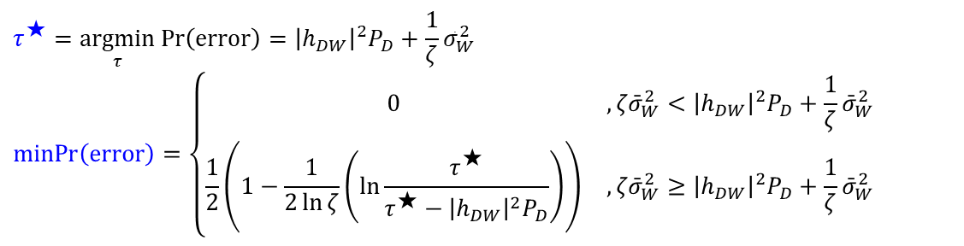
System Model
System Model Problem Formulation Proposed Solution Numerical Result Conclusion
2.2 Covert Message Detection
The worst-case assumption: $P_{D}$ known at the detector [HTa:20]
The minimum DEP and the optimal threshold $τ^{⋆}$
$$τ^{★}=\underset{τ}{argmin}\operatorname{Pr}\left(\text{error}\right)={\left|h_{DW}\right|}^{2}P_{D}+\frac{1}{ζ}{\bar{σ}}_{W}^{2} \\ \operatorname{minPr}\left(\text{error}\right)=\left\{\begin{matrix}0 & , ζ{\bar{σ}}_{W}^{2}<{\left|h_{DW}\right|}^{2}P_{D}+\frac{1}{ζ}{\bar{σ}}_{W}^{2} \\ \frac{1}{2}\left(1−\frac{1}{2\ln{ζ}}\left(\ln{\frac{τ^{★}}{τ^{★}−{\left|h_{DW}\right|}^{2}P_{D}}}\right)\right) & , ζ{\bar{σ}}_{W}^{2}≥{\left|h_{DW}\right|}^{2}P_{D}+\frac{1}{ζ}{\bar{σ}}_{W}^{2}\end{matrix}\right.$$

Slide 22
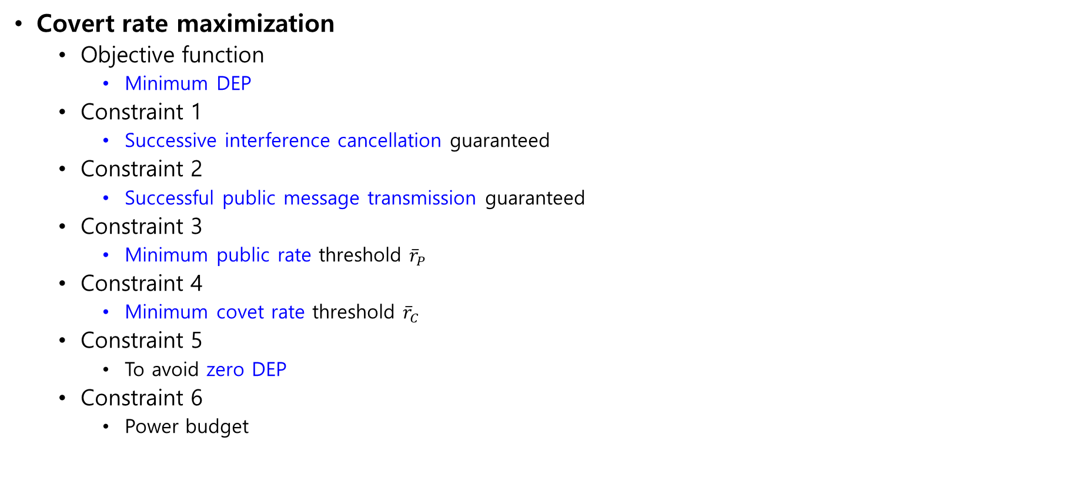

Problem Formulation
System Model Problem Formulation Proposed Solution Numerical Result Conclusion
Covert rate maximization
Objective function
Minimum DEP
Constraint 1
Successive interference cancellation guaranteed
Constraint 2
Successful public message transmission guaranteed
Constraint 3
Minimum public rate threshold ${\overline{r}}_{P}$
Constraint 4
Minimum covet rate threshold ${\overline{r}}_{C}$
Constraint 5
To avoid zero DEP
Constraint 6
Power budget
$$\text{P}\text{1})\text{: }\max_{P_{D},r_{P}} \operatorname{minPr}\left(\text{error}\right) \\ \text{subject} \text{to} r_{P}≤{\bar{r}}_{P,R} \\ r_{P}≤{\bar{r}}_{P,D} \\ r_{P}≥{\bar{r}}_{P} \\ r_{C,R}≥{\bar{r}}_{C} \\ ζ{\bar{σ}}_{W}^{2}≥{\left|h_{DW}\right|}^{2}P_{D}+\frac{1}{ζ}{\bar{σ}}_{W}^{2} \\ 0≤P_{D}≤{\bar{P}}_{D}$$

Slide 23

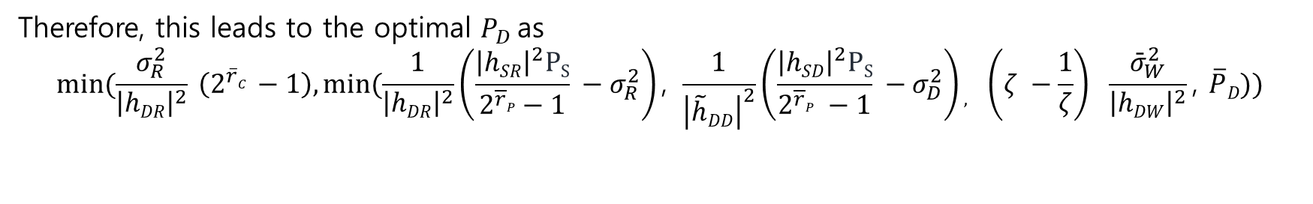
Proposed Solution
System Model Problem Formulation Proposed Solution Numerical Result Conclusion
Covert rate maximization
$P1.1):$ $\underset{PD}{\underbrace{min}} P_{D}$
Subject to :$PD≤\frac{1}{{\left|hDR\right|}^{2}}\left(\frac{{\left|hSR\right|}^{2}PS}{2^{\overline{r}P} −1} −σ_{R}^{2}\right)$
$PD≤\frac{1}{{\left|\tilde{h}DD\right|}^{2}}\left(\frac{{\left|hSD\right|}^{2}PS}{2^{\overline{r}P} −1} −σ_{D}^{2}\right)$
$PD≥\frac{σ_{R}^{2}}{{\left|hDR\right|}^{2}} (2^{{\overline{r}}_{C}}−1)$
$PD≤\left(ζ −\frac{1}{ζ}\right)$ $\frac{{\bar{σ}}_{W}^{2}}{{\left|hDW\right|}^{2}}$
$0≤P_{D}≤ \overline{P}D$
Therefore, this leads to the optimal $P_{D}$as
$$min⁡(\frac{σ_{R}^{2}}{{\left|hDR\right|}^{2}} \left(2^{\overline{r}C} −1\right),min⁡(\frac{1}{{\left|hDR\right|}^{2}}\left(\frac{{\left|hSR\right|}^{2}PS}{2^{\overline{r}P}−1} −σ_{R}^{2}\right)\text{, }\frac{1}{{\left|\tilde{h}DD\right|}^{2}}\left(\frac{{\left|hSD\right|}^{2}PS}{2^{\overline{r}P} −1} −σ_{D}^{2}\right), \left(ζ −\frac{1}{ζ}\right) \frac{{\bar{σ}}_{W}^{2}}{{\left|hDW\right|}^{2}}\text{, }\overline{P}D))$$

Slide 24
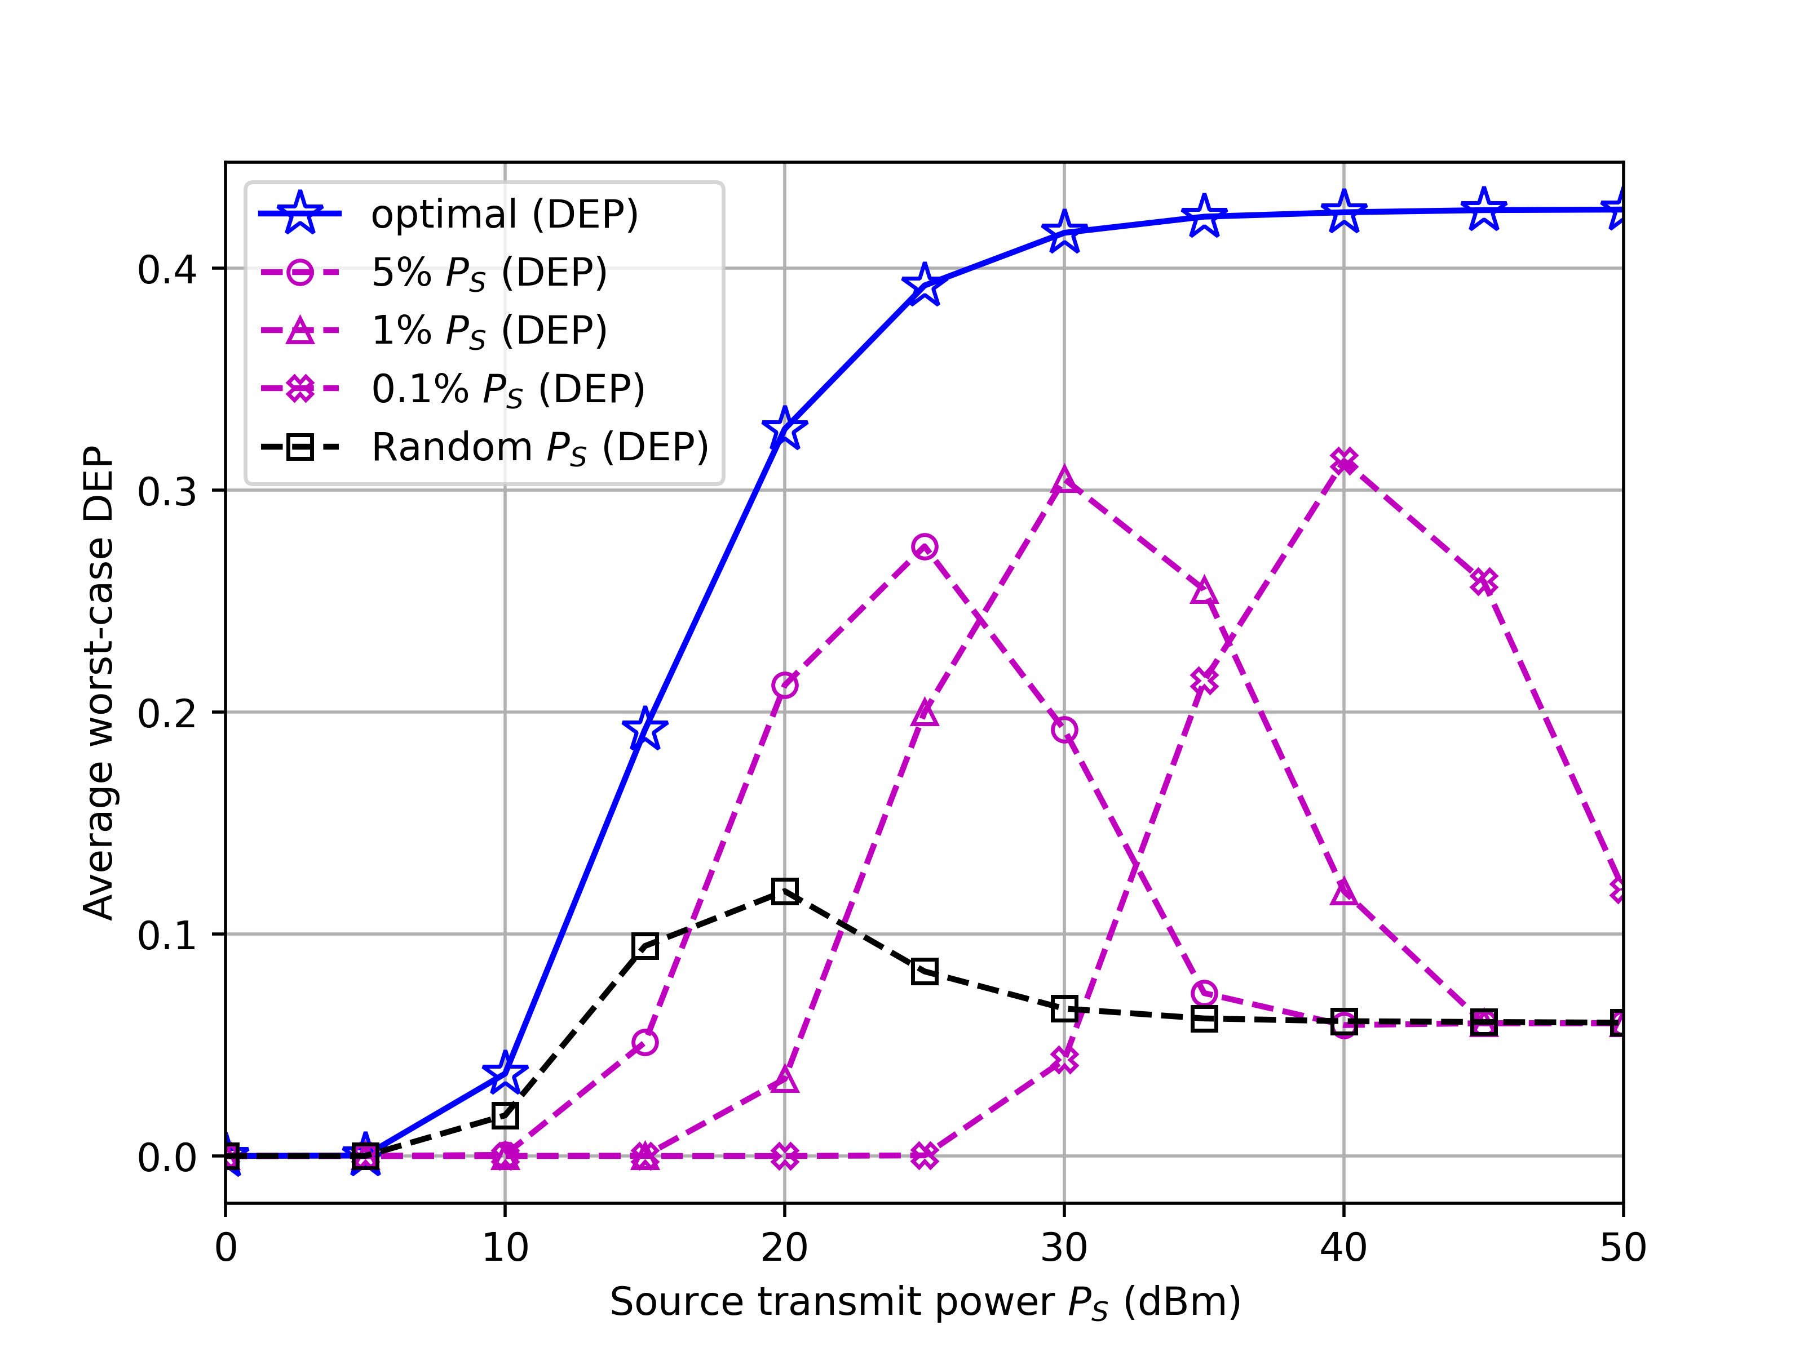

Numerical Result
System Model Problem Formulation Proposed Solution Numerical Result Conclusion
DEP vs. Source transmit power, $P_{S}$
Figure illustrates how the worst-case DEP changes with the source transmit power $P_{S}.$ To ensure successful covert communication, it is necessary for the destination transmit power $P_{D}$ to be significantly lower than $P_{S}$.

Slide 25
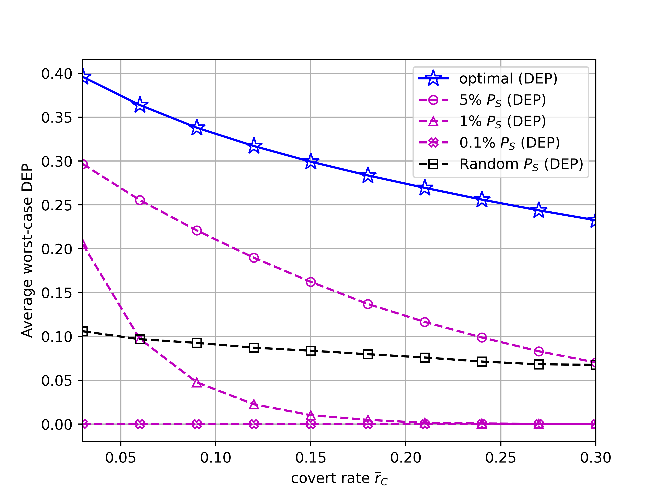

Numerical Result
System Model Problem Formulation Proposed Solution Numerical Result Conclusion
DEP vs. Minimum covert rate threshold,${\overline{r}}_{c}$
Figure presents a comparison of the average worst-case DEP with changes in the covert rate threshold ${\overline{r}}_{C}$. It's evident that the worst-case DEP exhibits a monotonically decreasing trend as the guaranteed covet rate increases.

Slide 26
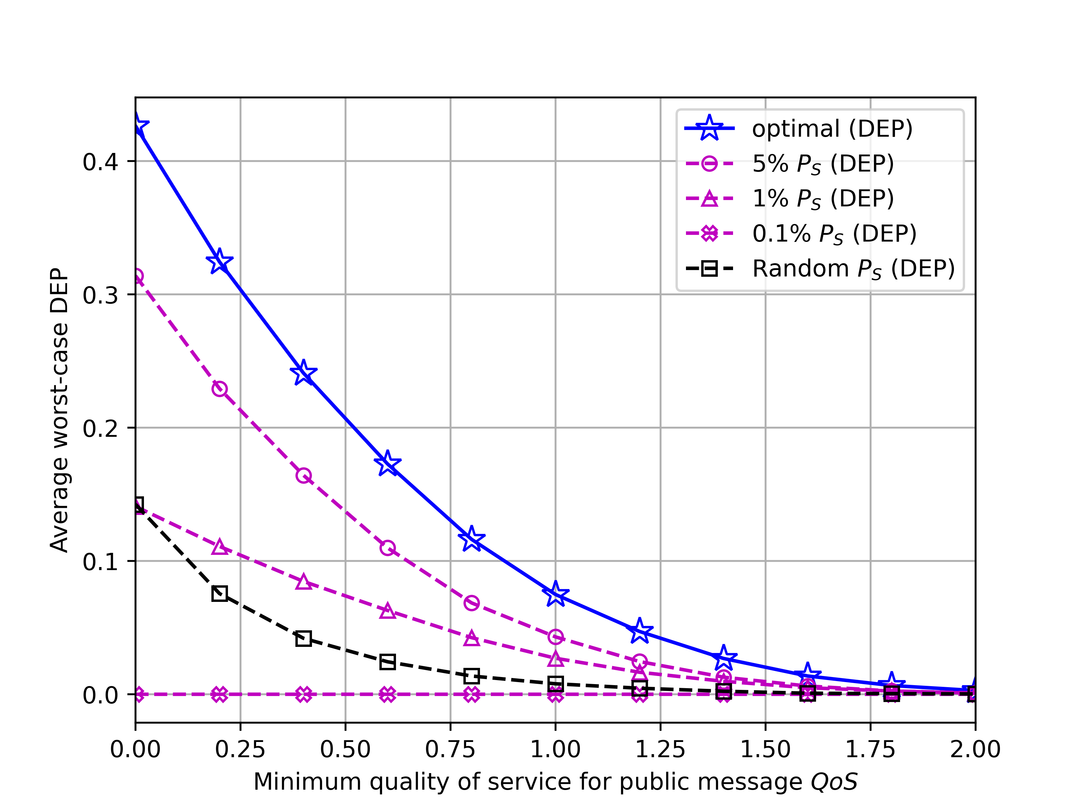

Numerical Result
System Model Problem Formulation Proposed Solution Numerical Result Conclusion
DEP vs. Minimum quality of service for public message, $QoS$
Figure illustrates the average worst-case DEP for different minimum quality of services for public message ${\overline{r}}_{P}$. The average worst-case DEP decline in monotonic manner as ${\overline{r}}_{P}$ increases.

Slide 27
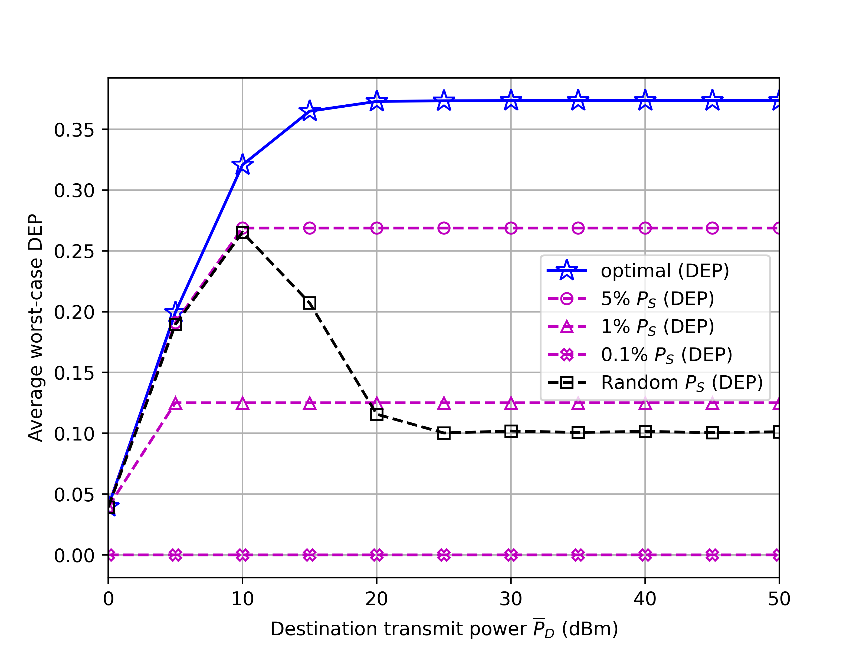

Numerical Result
System Model Problem Formulation Proposed Solution Numerical Result Conclusion
DEP vs. Destination transmit power budget, ${\overline{P}}_{D}$
Figure illustrates the average worst-case DEP​ for different the destination transmits power budget ​${\overline{P}}_{D}$.Close performance among the presented schemes for low ${\overline{P}}_{D}$ since the optimal $P_{D}$ is dominantly limited by ${\overline{P}}_{D}$.

Slide 28
Conclusion
System Model Problem Formulation Proposed Solution Numerical Result Conclusion
Covert communication setup
Source node -> disguised full-duplex destination node
Destination secretly transmit to the hidden receiver
Key Findings
Optimal Transmit Power:
Strong Destination-Receiver Link: Power tends towards zero
Self-Interference: Poor suppression leads to near-zero power
High Channel Gain to Warden: Power approaches zero
Insights:
Low transmit power avoids detection
Balance between covert communication and quality of service
Future Research:
Explore practical modulation techniques
Study the impact of imperfect CSI

Slide 29
Case 2: No channel information of eavesdroppers
Intro. Outline System Model Case I Case II Ext. Results Concl.
② Closed-form solution by worst-case approximation
Worst-case assumption where noise power is negligibly small at the eavesdroppers
Conservative assumption
An upper bound of the actual
Properties of the upper bound
increasing with
Minimum at

Slide 30
Extension
Intro. Outline System Model Case I Case II Ext. Results Concl.
Multi-user system (Chapter 2)
Goal
Secrecy performance maximization by jointly optimizing both the time allocation between the ET phase and the IT phases and the power allocation of the jammer for
ET phase
The n-th IT phase
: Energy signal
: Information signal
: Jamming signal
…
…
User n
User n
H-AP
…
H-AP
…
…
…
Jammer
Eavesdroppers
Jammer
Eavesdroppers

Slide 31
Numerical Results
Intro. Outline System Model Case I Case II Ext. Results Concl.
Case 1: Secrecy rate
Case 2: Secrecy outage probability
Compared schemes
Equal resource allocation (ERA)
Information rate maximization (IRM)
Secure transmission without jammer
35 %
10 dB
50 %

Slide 32
Conclusion of Part I
Intro. Outline System Model Case I Case II Ext. Results Concl.
Conclusion
Secrecy performance of wiretap WPCN with the aid of an EH jammer
Two different cases
Perfect channel state information
The optimal time allocation method for secrecy rate maximization
No channel state information
Both the optimal and closed-form time allocation method for secrecy outage minimization
Extension to multi-user scenarios
Future works
Relay-aided WPCN
Multiple jammers

Slide 33
Relay-assisted Proactive Eavesdropping with Cooperative Jamming
Part II

Slide 34
Introduction
Intro. Outline System Model Case I Case II Ext. Results Concl.
Wireless surveillance via proactive eavesdropping
Passive eavesdropping
A legitimate monitor only listening to the suspicious communications
Effective only when the eavesdropping link capacity is greater than or equal to the data rate of the suspicious users
Proactive eavesdropping [JXu:17a]
Proactive control on the channel condition in favor of eavesdropping
Suspicious link
Suspicious signal
Jamming signal
Suspicious
transmitter
Suspicious
receiver
Eavesdropping link
Simultaneous jamming
Legitimate monitor

Slide 35
Introduction
Intro. Outline System Model Case I Case II Ext. Results Concl.
Relay-assisted proactive eavesdropping
Common assumptions in literature [JXu:17b, CZhong:17]
Existence of a direct link between the monitor and the suspicious users
Possibly infeasible in practice (e.g., covert surveillance operation from a far distance)
→ Intermediate relays required
Two practical considerations for relays [TRiihonen:09]
Suspicious signal
Delayed suspicious signal
Suspicious
transmitter
Suspicious
transmitter
Central
monitor
Relay
Central
monitor
Relay
Concurrent
Interference
Suspicious
receiver
Suspicious
receiver
Negligible relay processing delay [YZeng:16]
e.g.) delay ≪ a symbol time period
Non-negligible relay processing delay
e.g.) delay > a symbol time period

Slide 36
Introduction
Intro. Outline System Model Case I Case II Ext. Results Concl.
Proposed relay-assisted proactive eavesdropping with a cooperative jammer
Goal
Eavesdropping rate maximization by optimizing the power allocation of the relay and the jammer
Suspicious signal
Forwarded signal
Jamming signal
Suspicious
transmitter
Central
monitor
Full-duplex Eavesdropping
relay
Suspicious
receiver
Jammer

Slide 37
Outline of Part II
Intro. Outline System Model Case I Case II Ext. Results Concl.
System model
Case 1: Negligible relay processing delay
Eavesdropping rate maximization
Case 2: Non-negligible relay processing delay
Eavesdropping rate maximization
Extension
Multi-antenna multi-relay system
Numerical results
Conclusion

Slide 38
System Model
Intro. Outline System Model Case I Case II Ext. Results Concl.
Case 1: Negligible relay processing delay
Received signals
At the eavesdropping relay
where
Notations
Cooperative jamming
: Transmit signal at node X
: Channel coefficient from node X to node Y
: Residual self-interference at node X
: Transmit power at node X
: Amplification factor
: AWGN at node X with power
Suspicious
transmitter
Central monitor
Eavesdropping relay
Suspicious
receiver
Jammer

Slide 39
System Model
Intro. Outline System Model Case I Case II Ext. Results Concl.
Case 1: Negligible relay processing delay
Received signals
At the central monitor
At the suspicious receiver
Suspicious
transmitter
Central monitor
Eavesdropping relay
Relay-like signal to the receiver
Suspicious
receiver
Jammer

Slide 40
System Model
Intro. Outline System Model Case I Case II Ext. Results Concl.
Case 2: Non-negligible relay processing delay
Received signals
At the eavesdropping relay
where
Cooperative jamming
Suspicious
transmitter
Central monitor
Eavesdropping relay
Suspicious
receiver
Jammer

Slide 41
System Model
Intro. Outline System Model Case I Case II Ext. Results Concl.
Case 2: Non-negligible relay processing delay
Received signals
At the central monitor
At the suspicious receiver
Suspicious
transmitter
Central monitor
Eavesdropping relay
Interference to the receiver
Suspicious
receiver
Jammer

Slide 42
Case 1: Negligible relay processing delay
Intro. Outline System Model Case I Case II Ext. Results Concl.
Signal-to-interference-plus-noise ratio (SINR)
and
where
Problem formulation
Optimal solution recovered by
Problem 3. Eavesdropping rate maximization for case 1
Intercepting as much data as possible
Non-convex
Eavesdropping channel link
≥ Data rate of the suspicious users

Slide 43
Case 1: Negligible relay processing delay
Intro. Outline System Model Case I Case II Ext. Results Concl.
Properties of
Constructive relay
Maximum achievable when
Destructive relay
Minimum achievable when
Suspicious
transmitter
Eavesdropping
relay
Suspicious
receiver

Slide 44

Case 1: Negligible relay processing delay
Intro. Outline System Model Case I Case II Ext. Results Concl.
Optimal solution for (P3)
Theorem 2. Three operation modes
The optimal solution for (P3) falls into one of the following three modes:
1) Destructive relaying with full jamming: and
2) Constructive relaying with jamming: and
3) Constructive relaying without jamming: and
Closed-form
solutions available
Mode 1
Data rate of the suspicious users
Mode 2
Mode 3
Eavesdropping channel link

Slide 45
Case 2: Non-negligible relay processing delay
Intro. Outline System Model Case I Case II Ext. Results Concl.
Signal-to-interference-plus-noise ratio (SINR)
and
where
Problem formulation
Problem 4. Eavesdropping rate maximization for case 2
Non-convex

Slide 46
Case 2: Non-negligible relay processing delay
Intro. Outline System Model Case I Case II Ext. Results Concl.
Two-step approach
Step 1: Unconstrained solution by first relaxing the jammer power constraint
Step 2: Retrieving the true optimal solution if the obtained jamming power from (P4.1) is
Closed-form solution available
Problem 4.1. Unconstrained problem for case 2
Solved by the two-layer algorithm (Part I.)
Theorem 3. The optimal jamming power for the original problem (P4)
If , the optimal jamming power for the original problem (P4) is

Slide 47
Extension
Intro. Outline System Model Case I Case II Ext. Results Concl.
Multi-antenna multi-relay system (Chapter 3 and 4)
Goal
Eavesdropping rate maximization by jointly optimizing the receive combining vector at the central monitor, the precoders at the relays and the transmit covariance matrix at the jammer
Suspicious signal
Forwarded signal
Jamming signal
…
Suspicious
transmitter
Eavesdropping
relay
Central
monitor
…
Suspicious
receiver
Jammer

Slide 48
Numerical Results
Intro. Outline System Model Case I Case II Ext. Results Concl.
Case 1: Negligible relay processing delay
Case 2: Non-negligible relay processing delay
68 %
High
Low
Channel condition of the suspicious users

Slide 49
Conclusion of Part II
Intro. Outline System Model Case I Case II Ext. Results Concl.
Conclusion
A scenario where a distant central monitor covertly wiretaps the communication between a pair of suspicious users via a full-duplex relay and a cooperative jammer
Two different cases
Negligible relay processing delay
Three optimal operation modes with the closed-form optimal solutions
Non-negligible relay processing delay
Two-step optimization approach for the optima power optimization
Extension to multi-antenna multiple relay scenarios
Future works
Absence of global channel state information
Active suspicious users with anti-eavesdropping or anti-jamming capabilities

Slide 50
Reference
[RZhang:13] Rui Zhang and Chin Keong Ho, “MIMO broadcasting for simultaneous wireless information and power transfer,” IEEE Trans. Wireless Commun. vol. 12, pp. 1989-2001, May 2013.
[HJu:14] Hyungsik Ju and Rui Zhang, “Throughput maximization in wireless powered communication networks,” IEEE Trans. Wireless Commun. vol. 13, pp. 418-428, Jan. 2014.
[LLiu:14] Liang Liu, Rui Zhang and Kee-Chaing Chua, “Secrecy wireless information and power transfer with MISO beamforming,” IEEE Trans. Signal Process. vol. 64, pp. 1850-1863, Apr. 2014.
[DWKNg:14] Derrick Wing Kwan Ng, Ernest S. Lo and Robert Schober, “Robust beamforming for secure communication in systems with wireless information and power transfer,” IEEE Trans. Wireless Commun. vol. 13, pp. 4599-4615, Aug. 2014.
[HXing:16a] Hong Xing, Liang Liu and Rui Zhang, “Secrecy wireless information and power transfer in fading wiretap channel,” IEEE Trans. Veh. Technol. vol.65, pp. 180-190, Jan. 2016.
[WLiu:16] Wanchun Liu, Xiangyun Zhou, Salman Durrani and Petar Popovski, “Secure communication with a wireless-powered friendly jammer,” IEEE Trans. Wireless Commun. vol. 15, pp. 401-415, Jan. 2016.
[HXing:15b] Hong Xing and Kai-Kit Wong and Zheng Chu and Arumugam Nullanathan, ”To harvest and jam: a paradigm of self-sustaining friendly jammers for secure AF relaying,” IEEE Trans. Signal Process. vol. 63, pp. 6616-6631, Dec. 2015.
[JXu:17a] Jie Xu, Lingjie Duan and Rui Zhang, “Surveillance and intervention of infrastructure-free mobile communications: a new wireless security paradigm,” IEEE Wireless Commun. vol. 24, pp. 152-159, Aug. 2017.
[JXu:17b] Jie Xu, Lingjie Duan and Rui Zhang, “Proactive eavesdropping via cognitive jamming in fading channels,” IEEE Trans. Wireless Commun. vol. 16, pp. 2790-2806, May 2017.
[CZhong:17] Caijun Zhong, Xin Jiang, Fengzhong Qu and Zhaoyang Zhang, ”Multi-antenna wireless legitimate surveillance systems: design and performance analysis,” IEEE Trans. Wireless Commun. vol. 16, pp. 4585-4599, Jul. 2017.
[YZeng:16] Yong Zeng and Rui Zhang, “Wireless information surveillance via proactive eavesdropping with spoofing relay,” IEEE J. Sel. Topics Signal Process., vol. 10, pp. 1449-1461, Dec. 2016.

Slide 51
Publications
Journal
International journals
1. Younghyun Jeon, Seok-Hwan Park, Changick Song, Jihwan Moon*, Seungjoo Maeng and Inkyu Lee, "Joint designs of fronthaul compression and precoding for full-duplex cloud radio access networks,“ IEEE Wireless Communications Letters, Vol. 5, No. 6, pp. 632 - 635, Dec. 2016.
2. Jihwan Moon*, Hoon Lee, Changick Song and Inkyu Lee, "Secrecy performance optimization for wireless powered communication networks with an energy harvesting jammer,“ IEEE Transactions on Communications, Vol. 65, No. 2, pp. 764 - 774, Feb. 2017.
3. Hoon Lee, Changick Song, Jihwan Moon* and Inkyu Lee, "Precoder designs for MIMO gaussian multiple access wiretap channels,“ IEEE Transactions on Vehicular Technology, Vol. 66, No. 9, pp. 8563 - 8568, Sept. 2017.
4. Hanjin Kim, Hoon Lee, Seokju Jang, Jihwan Moon* and Inkyu Lee, "Maximization of minimum rate for wireless powered communication networks in interference channel,“ IEEE Communications Letters, Vol. 22, No. 8, pp. 1648 - 1651, Aug. 2018.
5. Jihwan Moon*, Hoon Lee, Changick Song, Sunho Lee and Inkyu Lee, "Proactive eavesdropping with full-duplex relay and cooperative jamming,“ IEEE Transactions on Wireless Communications, Vol 17, No. 10, pp. 6707 - 6719, Oct. 2018.
6. Jihwan Moon*, Hoon Lee, Changick Song, Seowoo Kang and Inkyu Lee, "Relay-assisted proactive eavesdropping with cooperative and spoofing,“ IEEE Transactions on Wireless Communications, Vol. 17, No. 10, pp. 6958 - 6971 Oct. 2018.
7. Jihwan Moon*, Sanghyun Lee, Hoon Lee and Inkyu Lee, “Proactive eavesdropping with jamming and eavesdropping mode selection,“ submitted to IEEE Transactions on Wireless Communications.

Slide 52
Publications
Conference
International conference
1. Jihwan Moon*, Hoon Lee, Changick Song and Inkyu Lee, "Secrecy outage minimization for wireless powered communication networks with an energy harvesting jammer,“ 2016 IEEE Global Communications Conference (GLOBECOM), Washington, DC, USA, 4 - 8 Dec. 2016.
2. Jihwan Moon* and Inkyu Lee, "Secrecy performance of wireless powered communication network,“ The 32nd International Technical Conference on Circuits, Systems, Computers, and Communications (ITC-CSCC), Busan, Korea, 2 - 5 Jul. 2017.
3. Jihwan Moon*, Hoon Lee, Changick Song and Inkyu Lee, "Multiple amplify-and-forward full-duplex relays for legitimate eavesdropping,“ 2018 IEEE International Conference on Communications (ICC), Kansas City, MO, USA, 20 - 24 May 2018.
4. Jihwan Moon*, Hoon Lee, Changick Song and Inkyu Lee, "Time allocation methods for secure wireless powered communication networks,“ 2018 IEEE 88th Vehicular Technology Conference (VTC Fall), Chicago, IL, USA, 27 – 30 Aug. 2018.
5. Jihwan Moon*, Hoon Lee, Changick Song, Seowoo Kang, Minseok Kim and Inkyu Lee, “Full-duplex spoofing relays for wireless surveillance,“ submitted to 2019 IEEE International Conference on Communications (ICC).
6. Jihwan Moon*, Sanghyun Lee, Hoon Lee, Seunghwan Baek and Inkyu Lee, “Deep learning-based proactive eavesdropping for wireless surveillance,“ submitted to 2019 IEEE International Conference on Communications (ICC).
Domestic conference
1. Younghyun Jeon, Seok-Hwan Park, Changick Song, Jihwan Moon*, Seungjoo Maeng and Inkyu Lee, "Fronthaul designs with self-interference mitigation for full-duplex cloud radio access networks,“ 2017 Winter Conference of Korea Information and Communications Society, 18 - 20 Jan. 2017.
2. Hanjin Kim, Hoon Lee, Seokju Jang, Jihwan Moon*, Junhee Park and Inkyu Lee, "Maximization of minimum rate for wireless powered communication networks in interference channel,“ 2018 Winter Conference of Korea Information and Communications Society, 17 - 19 Jan. 2018.

